Slide 1
DPR Agent TKI
PromptlyAI

Slide 2

Key Benefits & Impact
PromptlyAI
90% faster
90% faster
6 months → 3 days for complete DPR generation
No SME required
Experts focus on review/approval, not drafting
Consistency by design
Standardized assumptions and annexure alignment
Compliance-first
MSE-CDP structure, ratios, and documentation guardrails
Cost savings
Fewer iterations, higher throughput per analyst

Slide 3
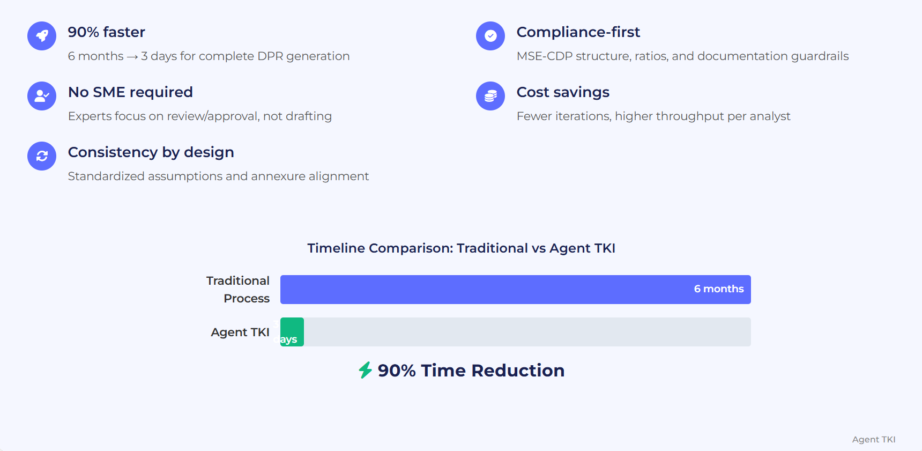

Slide 4
Model Integration & Agent Orchestration
Agentic AI
Beginners Boot camp
PromptlyAI

Slide 5
Prerequisite
PromptlyAI
Python
Datatypes: Strings, Lists, Dictionaries,
Functions
Class & Objects
Modules

Slide 6
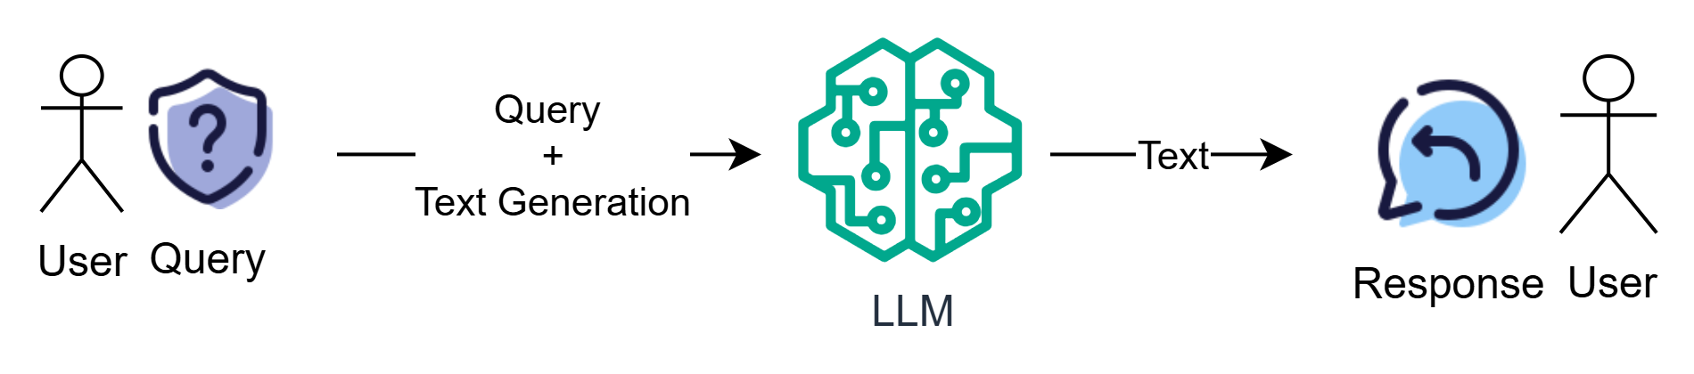
Text Generation
PromptlyAI

Slide 7
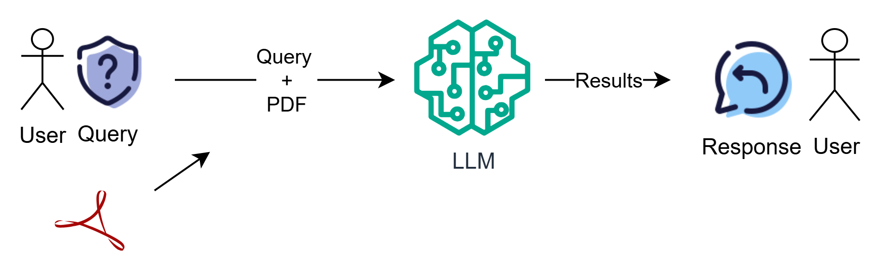
PDF Processing
PromptlyAI

Slide 8
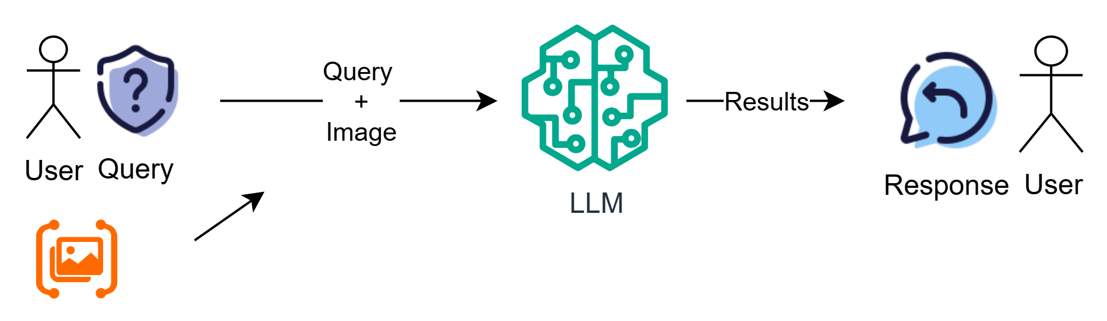
Image Processing
PromptlyAI

Slide 9
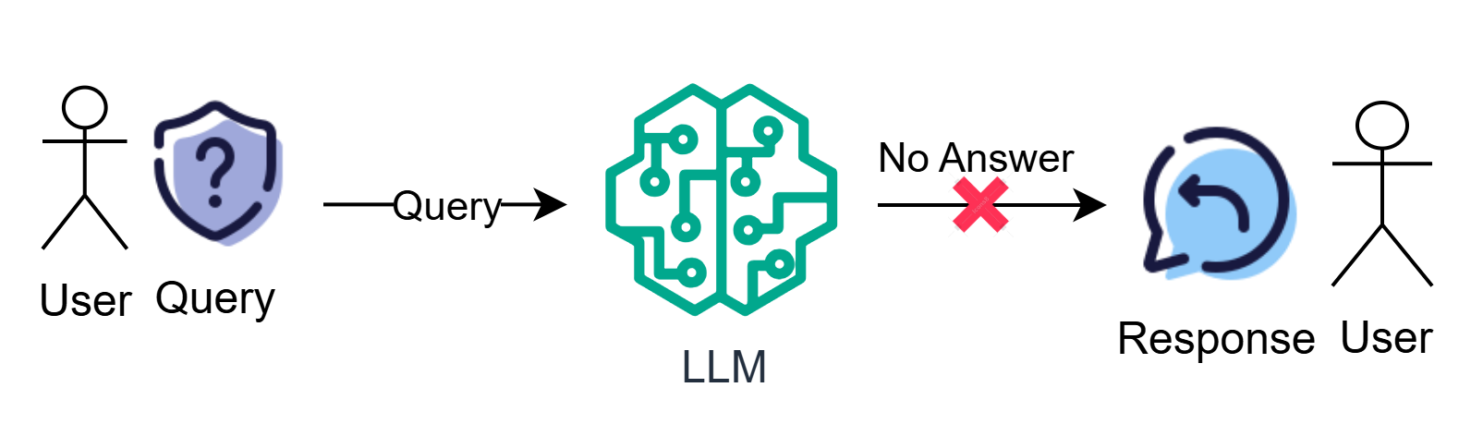
LLM Limitations
PromptlyAI

Slide 10
Natural Language Processing
PromptlyAI
Problem Statements
Add 20 and 30
Add twenty and 30
Add twenty and 30, then multiply by 10
Find the sum of twenty and thirty
PromptlyAI intends to distribute 50% of its annual profit as bonuses to employees, weighted by their performance ratings.

Slide 11
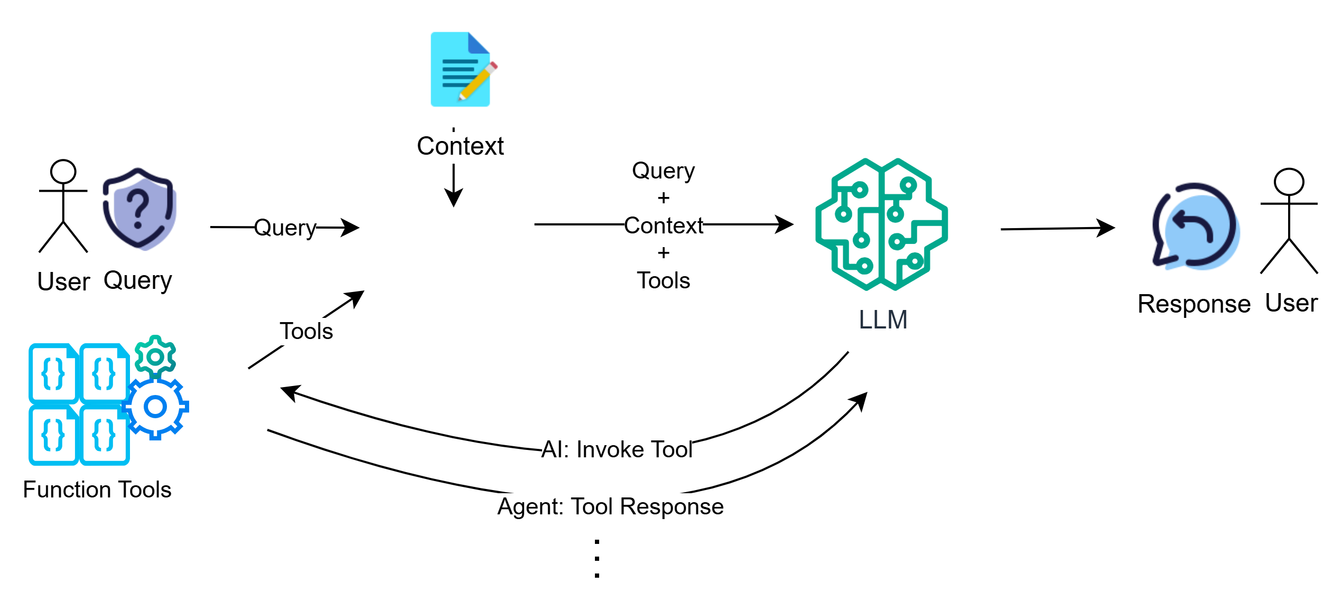
Function Tools
PromptlyAI

Slide 12
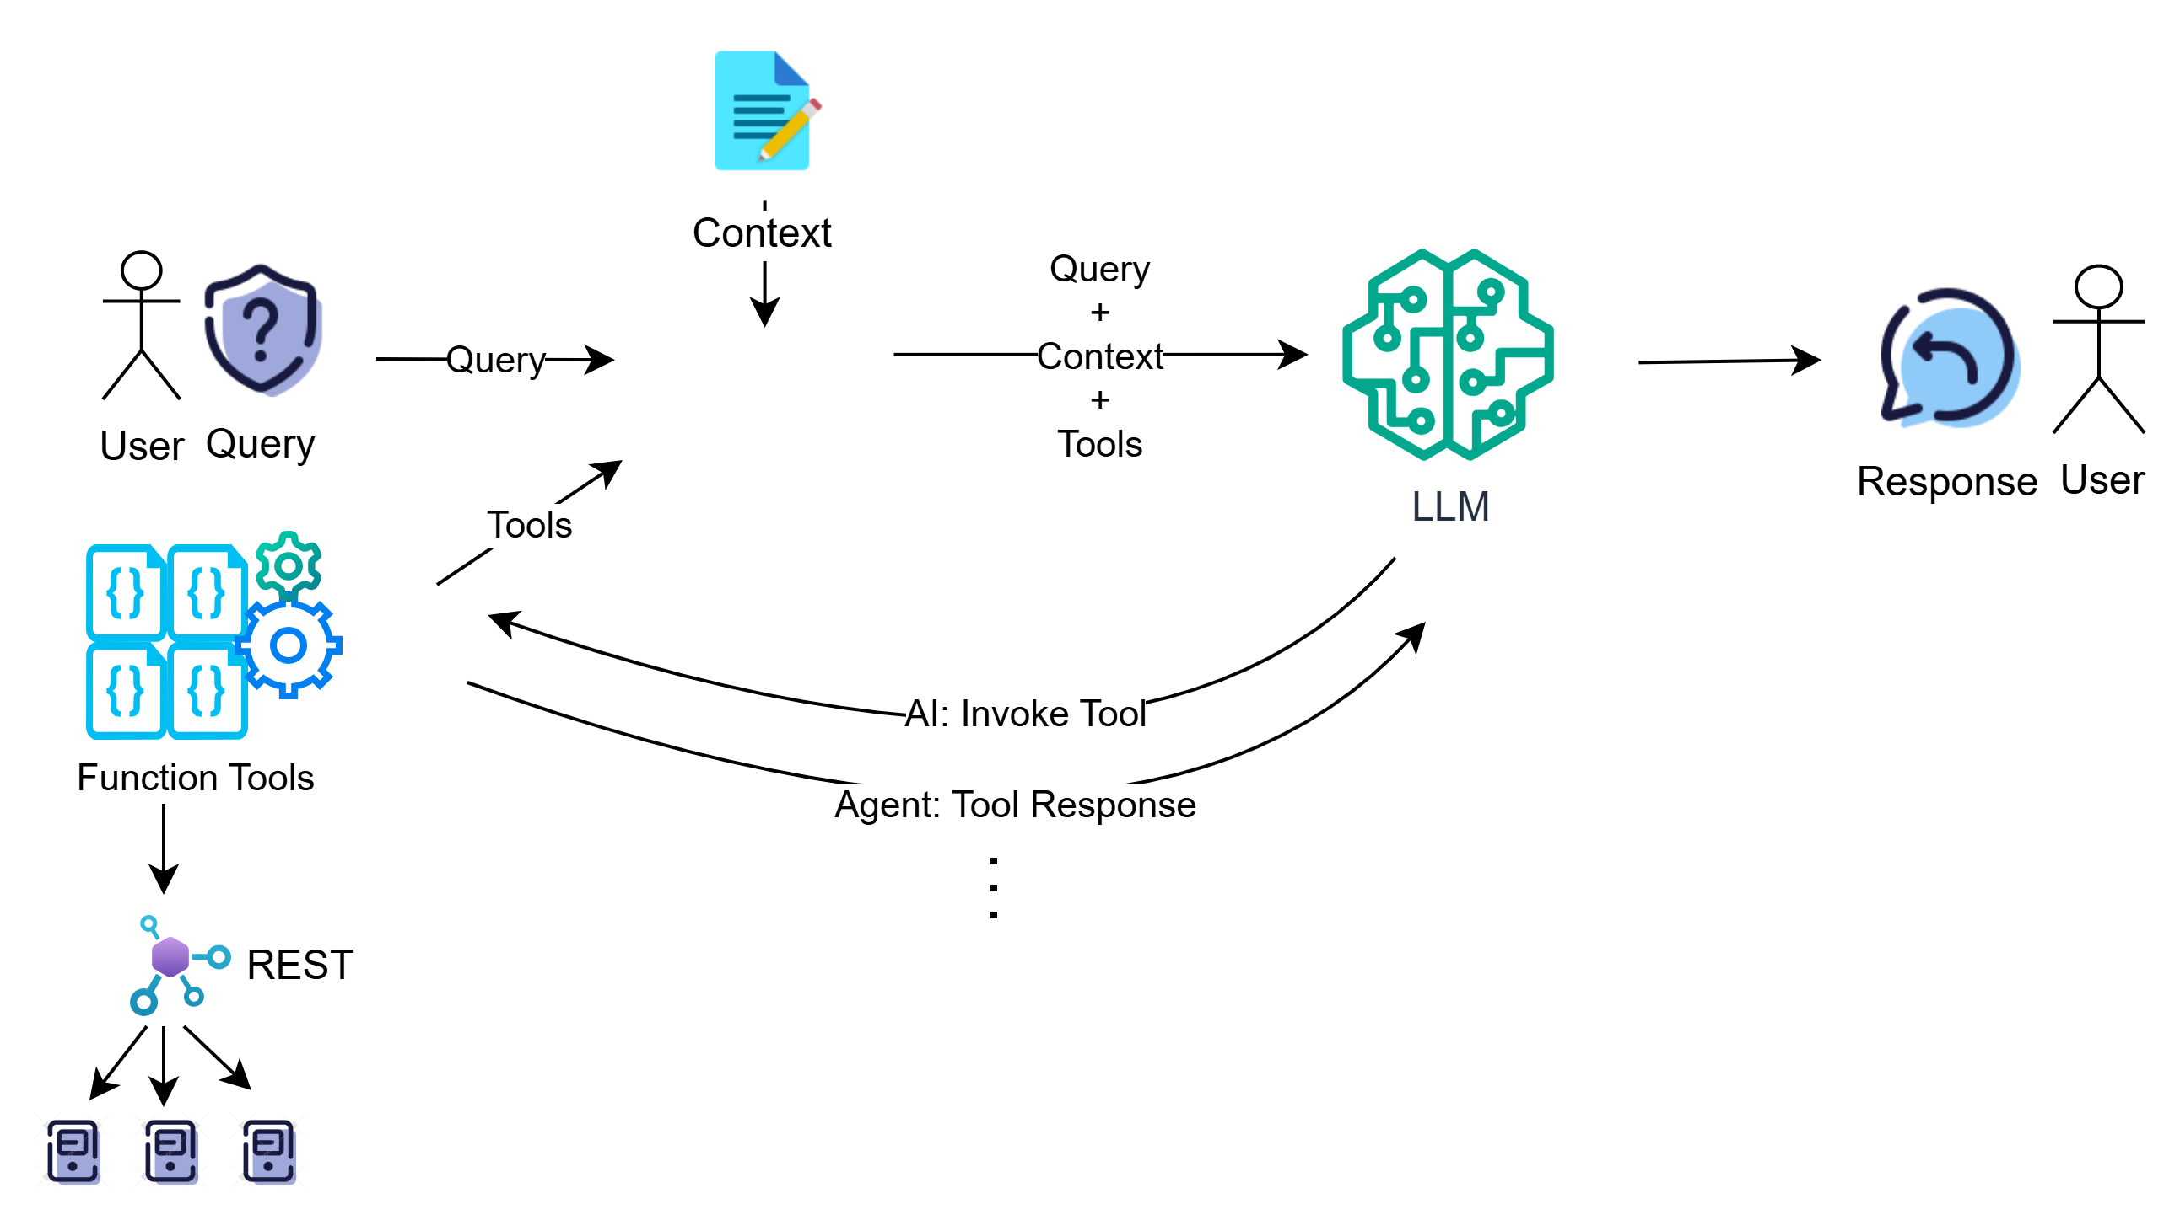
Function Tools Capabilities
PromptlyAI

Slide 13
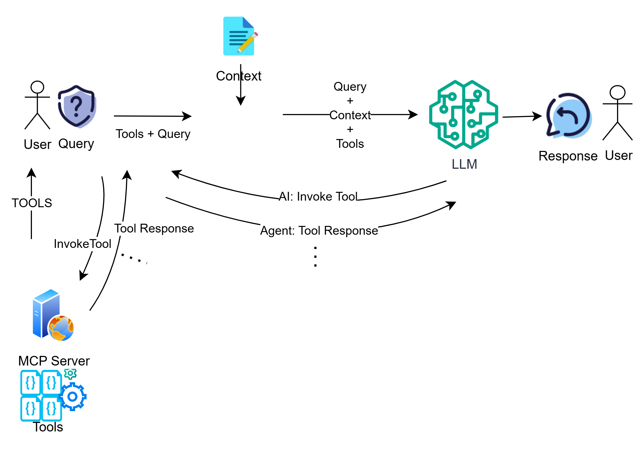
MCP Server
PromptlyAI

Slide 14
Demo Session Agenda – AI Agent Showcase
PromptlyAI
EnquiryBot – Smart Enquiry Processing
Automates handling of incoming enquiries via Gmail
Integrates LLM and Google Sheets for seamless orchestration
Speeds up lead response and data entry
Issue Sense Agent – Duplicate Issue Detection
Searches Jira for similar or duplicate issues
Uses Gemini for semantic similarity matching
Helps prevent redundant issue creation
DevOps Copilot – AI-Powered Engineering Assistant
Automates code review, test generation, and commit analysis
Diagnoses CI/CD pipeline issues and validates tickets
Powered by Gemini 2.0 Flash for fast, intelligent decisions

Slide 15
PromptlyAI
📨 Enquiry-Bot
“Turn every enquiry into an opportunity — automate and accelerate responses with intelligent orchestration.”
🧭 Issue Sense Agent
“Eliminate duplicates before they happen — empower teams with smart, proactive issue detection.”
🛠️ DevOps Copilot
3“Supercharge your development pipeline — AI-driven copilots that work smarter, faster, and flawlessly.”

Slide 16














Enquiry Bot & Agents
PromptlyAI
Classify emails
Detect course
Add comment
Gmail
LLM
Send replies
Master Agent
Gmail
GSheets
Report
Fetch emails
Extract fields
Store enquiries
Update comments
Task: You are EnquiryBot. Orchestrate Gmail, LLM, and Sheets agents to process enquiries”

Slide 17
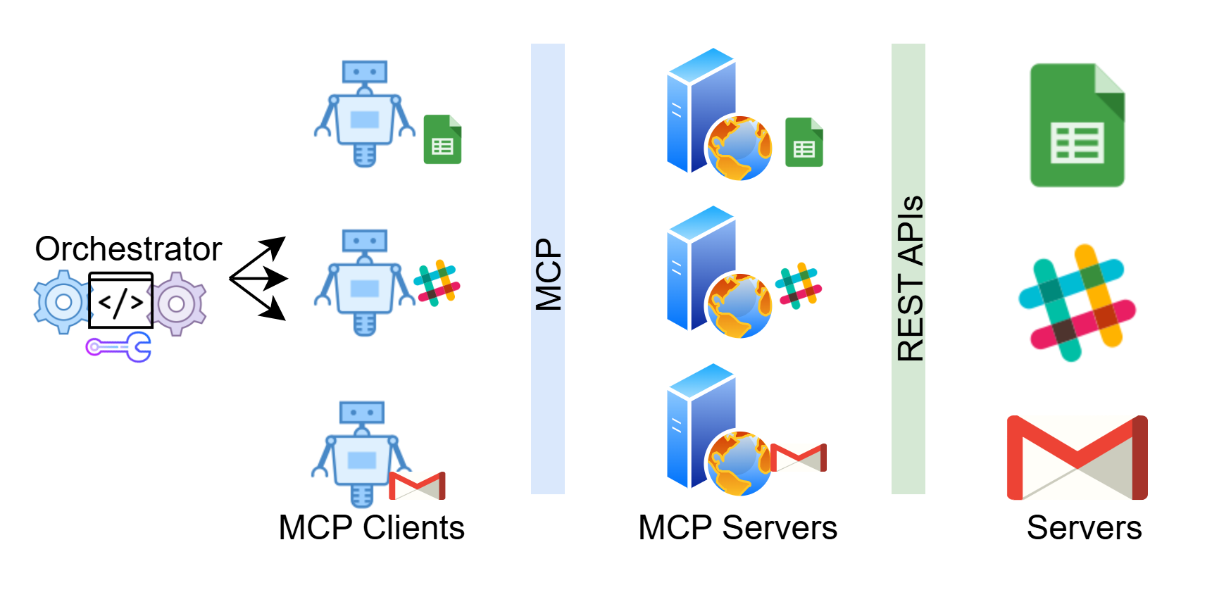
Enquiry Bot
PromptlyAI

Slide 18

Jira: Issue Sense Agent
PromptlyAI
✅
New Issue:
Input Validation
Step 1
🔍
Jira Search:
Find Candidates
Step 2
LLM: AI-Powered Analysis
Step 3
📊
Results:
Rank & Report
Step 4

Slide 19

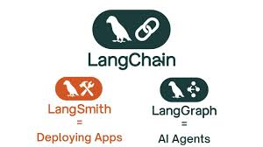
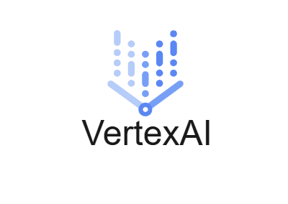
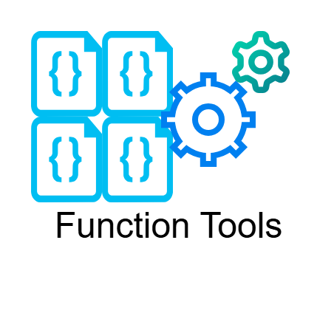

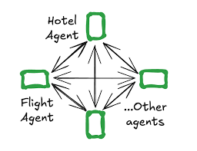
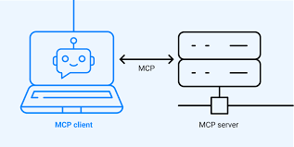
Models, Tools, Frameworks
PromptlyAI

Slide 20
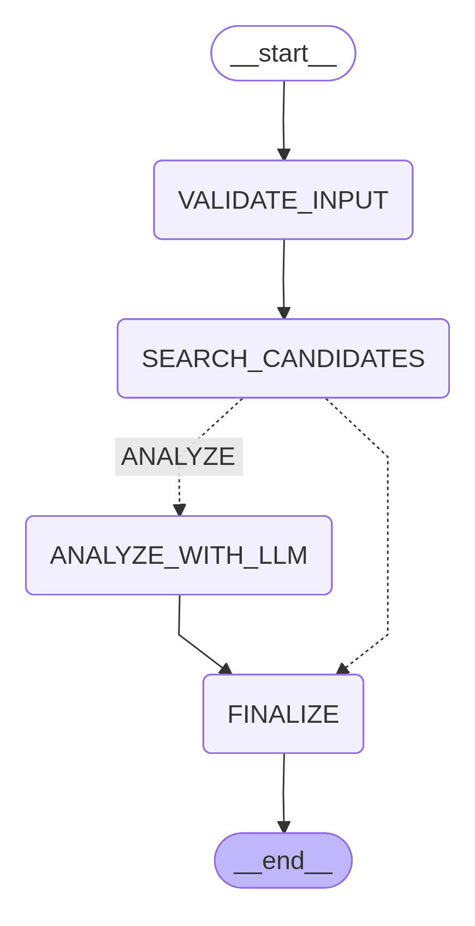
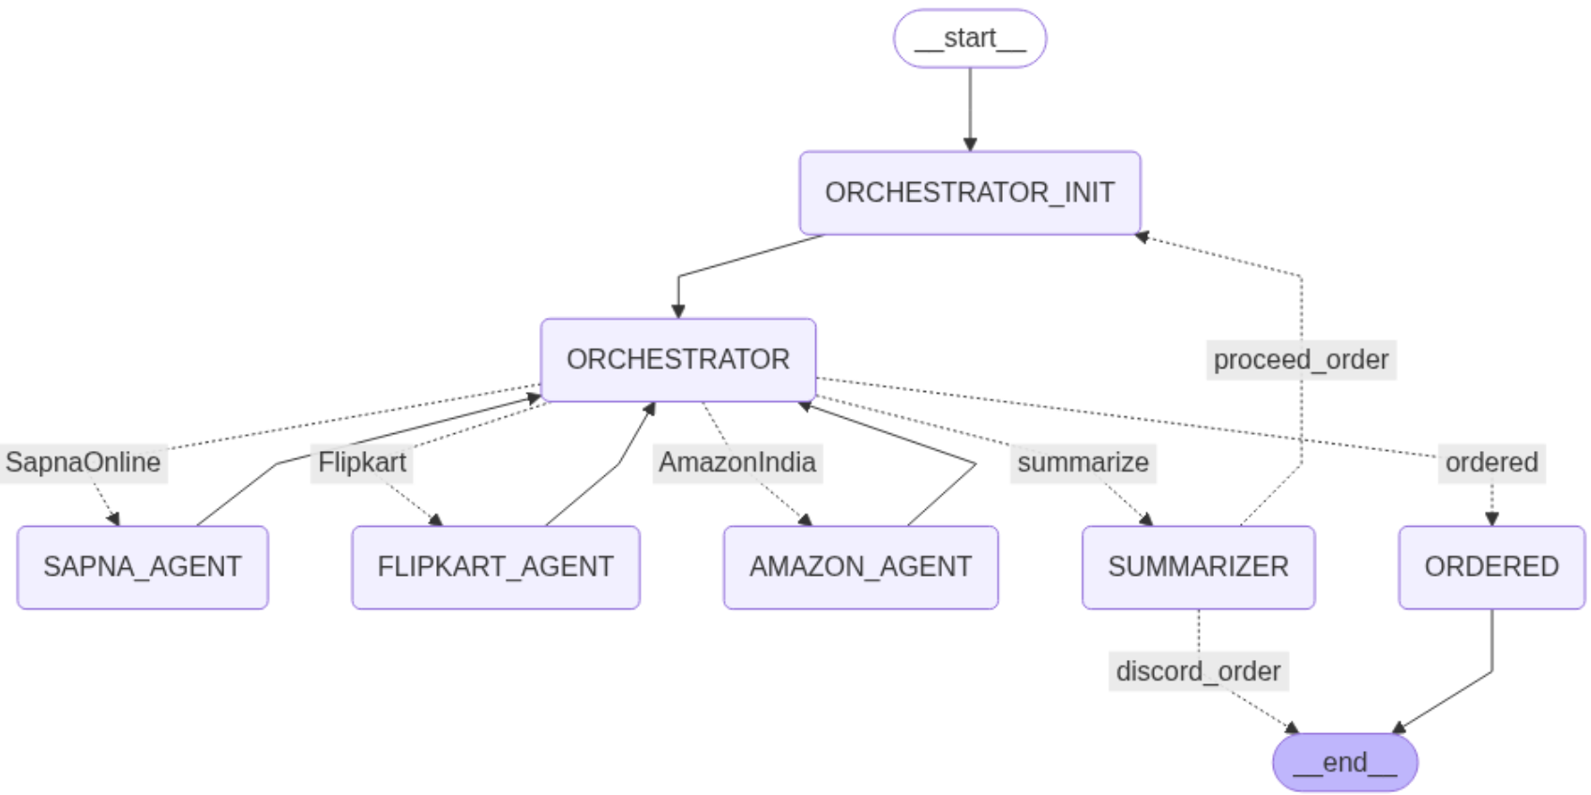
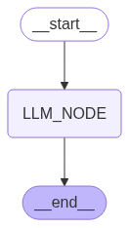
Framework - Langgraph
PromptlyAI

Slide 21
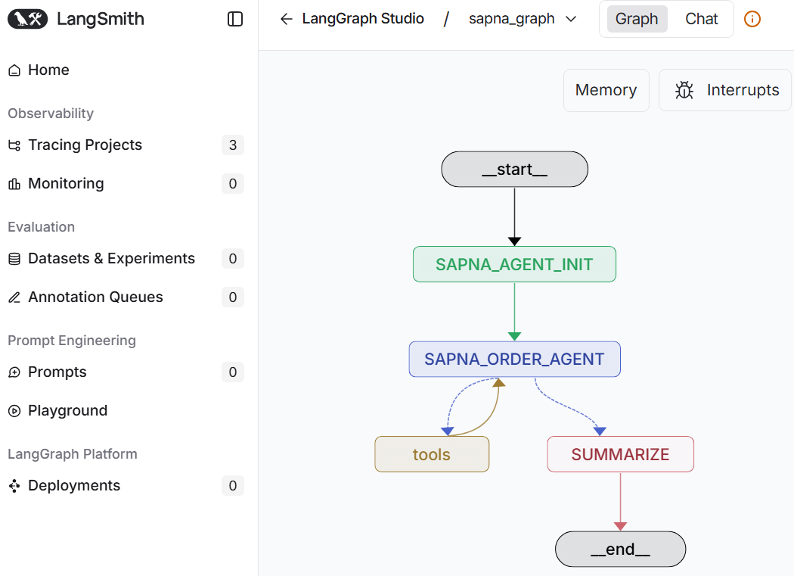
Debugging - LangSmith
PromptlyAI

Slide 22
Knowledge Support & Duration
PromptlyAI
📘 Shared learning material
🎥 Online Session recordings
📝 Handson & Practical assignments
🤝 Ongoing assistance
⏰ Duration: ~30–35 hours (27 hours core + buffer)
Notes:
What is not covered
How LLMs works
What is the architecture of LLMs
How to Build LLMs
ML Algorithms
Deep Learning Algos

Slide 23

🎯 Facts & Success Stories
PromptlyAI
👨‍🎓
Training Impact
Trained 500+ students directly
Trained 1000+ Professionals through Corporate programs
🏆
Proven Results
100% Placement Record
👥
Batch Quality
20-25 Learners Per Batch
Exclusive Offer
For 10 Early birds
Trusted Learner
⭐ ⭐ ⭐ ⭐⭐
Google Reviews https://share.google/U9e2uWVZwXapjXCfK

Slide 24
Thank you
PromptlyAI
📞97310 96750
📧support@promptlyai.com
🌐promptlyai.in
77/1, Marathahalli,
Bengaluru - 560103

Slide 25
Context & Retrieval (RAG)
Agentic AI
Knowledge System
PromptlyAI

Slide 26
Prerequisite
PromptlyAI
Python
Datatypes: Strings, list, dictionaries,
Functions
Class & Objects
Modules

Slide 27
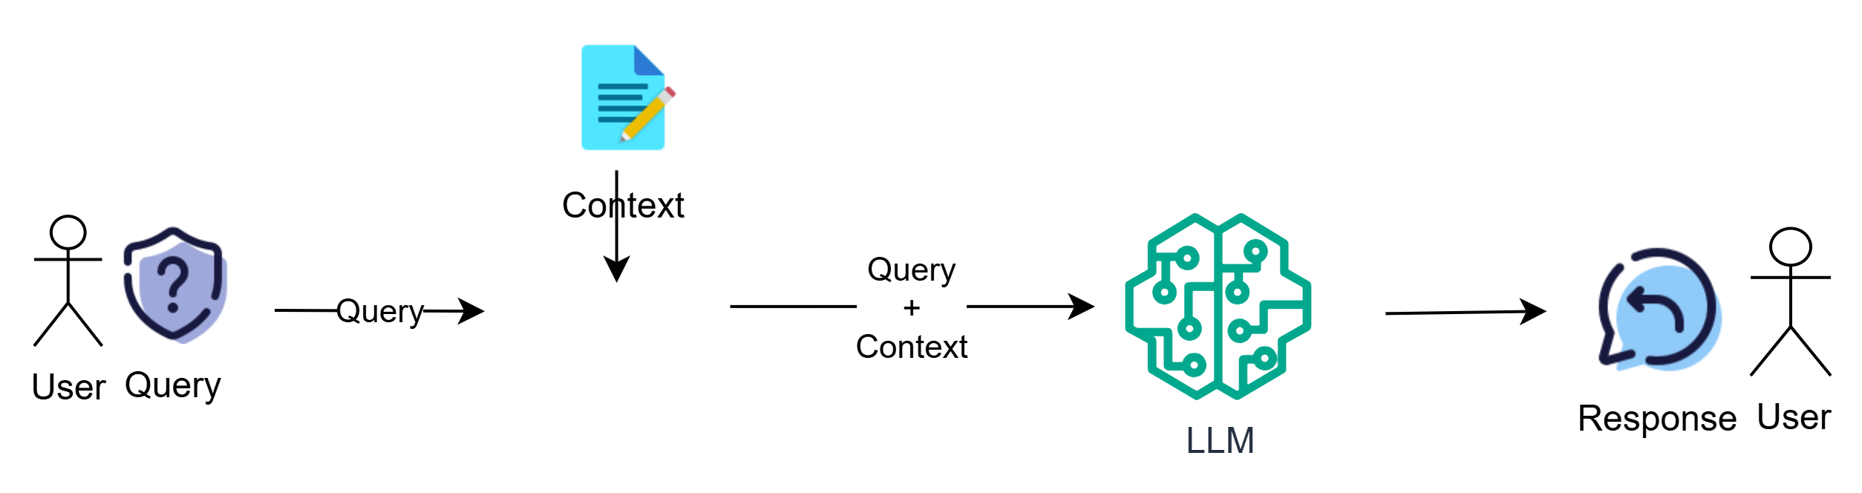
Agentic AI: Knowledge System
PromptlyAI

Slide 28
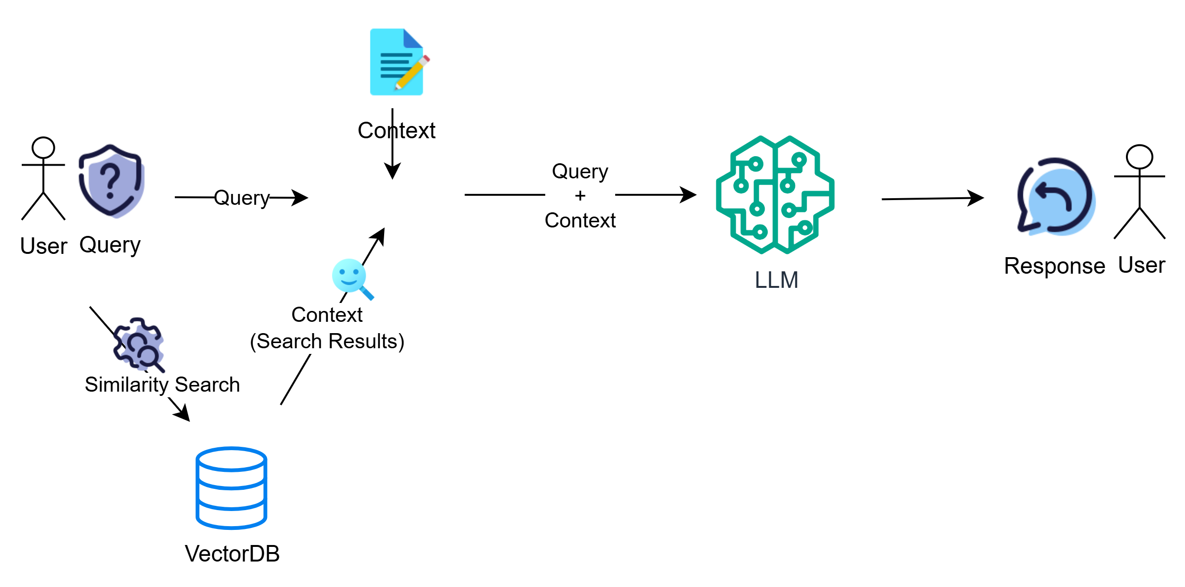
Agentic AI: Knowledge System
PromptlyAI

Slide 29
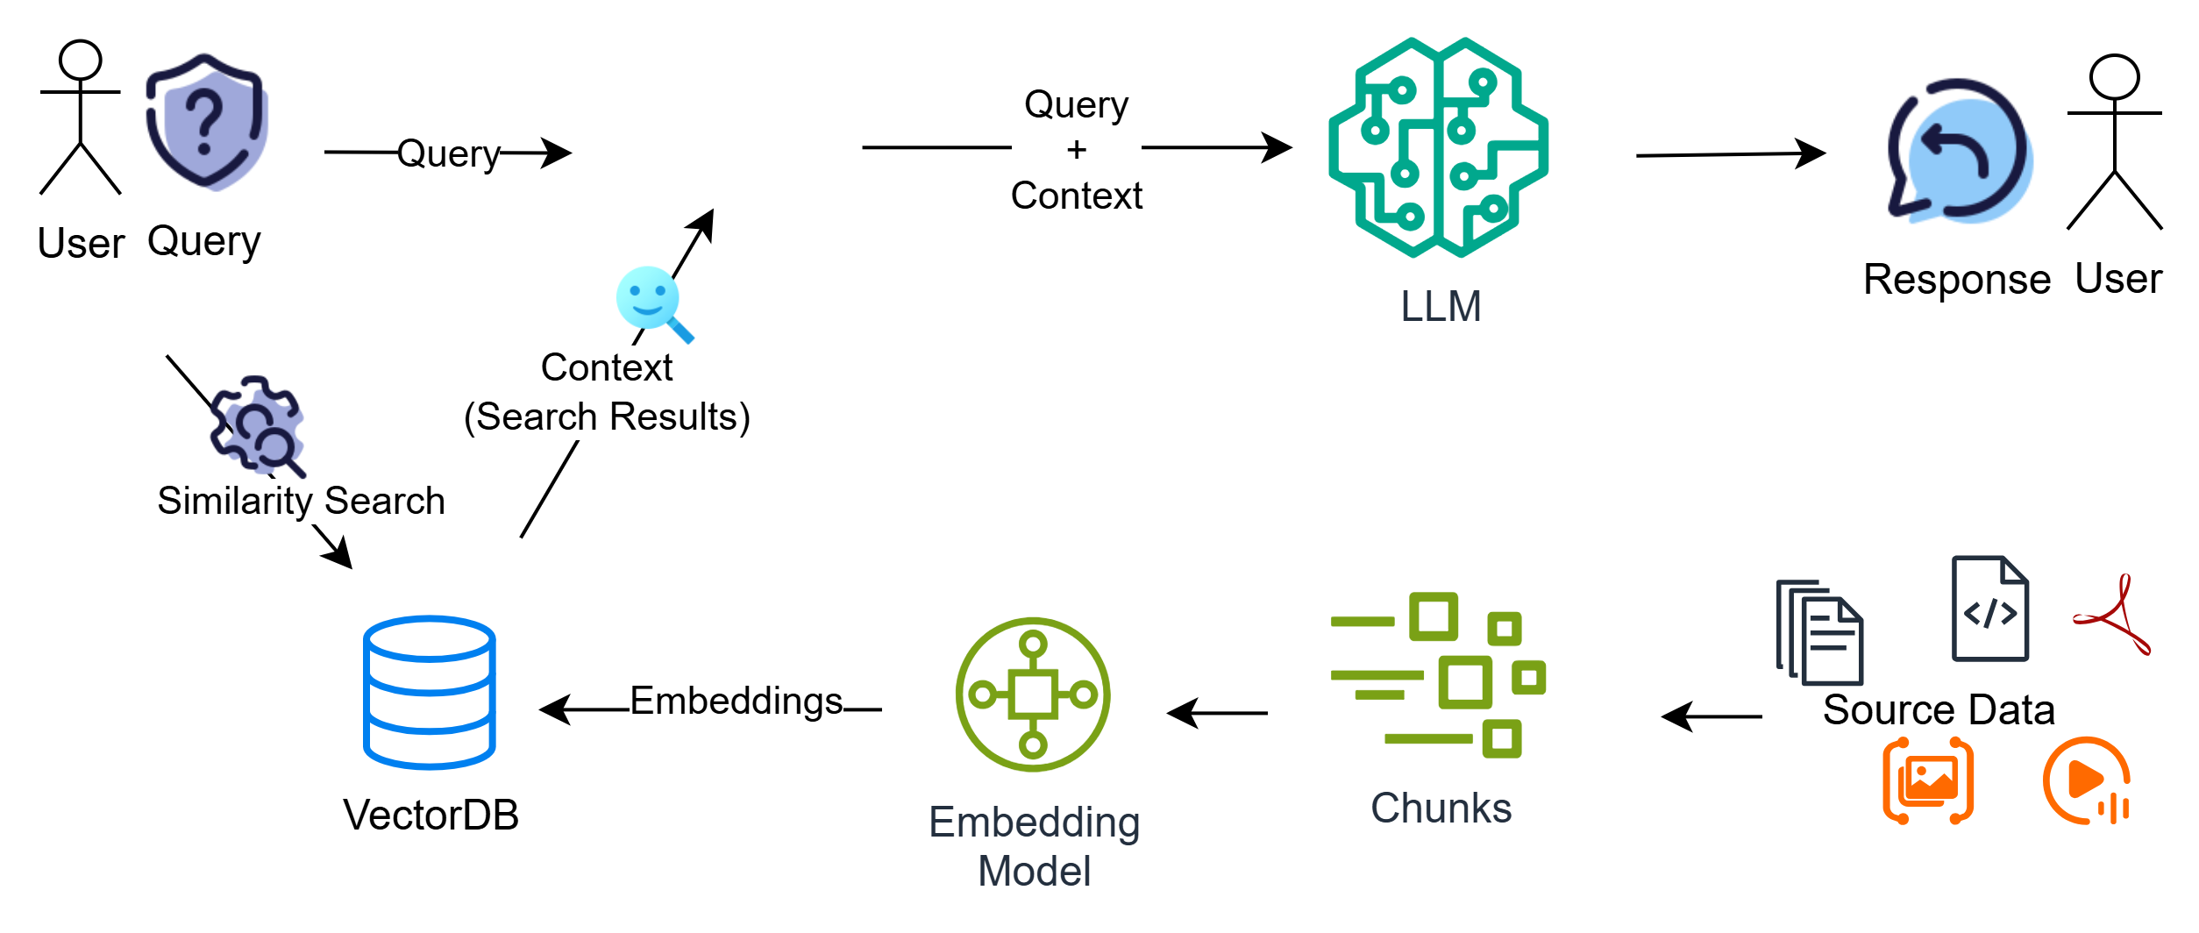
Agentic AI: Knowledge System
PromptlyAI

Slide 30
Knowledge Support & Duration
PromptlyAI
📘 Shared learning material
🎥 Session recordings
📝 Practical assignments
🤝 Ongoing assistance
⏰ Duration: ~30–35 hours (27 hours core + buffer)
Notes:
What is not covered
How LLMs works
What is the architecture of LLMs
How to Build LLMs
ML Algorithms
Deep Learning Algos

Slide 31
PromptlyAI
Delivery Mode – Online, Teams
PromptlyAI - AgenticAI Beginners Bootcamp | Meeting-Join
Schedule
Weekend / Weekday
Materials are shared @
Shared folder
Recording Link is shared after every session
Handson

Slide 32
🎯 Facts & Success Stories
PromptlyAI
👨‍🎓
Training Impact
Trained 500+ students directly
Trained 1000+ Professionals through Corporate programs
🏆
Proven Results
100% Placement Record
👥
Batch Quality
20-25 Learners Per Batch
Exclusive Offer
For 10 Early birds
Trusted Learner
⭐ ⭐ ⭐ ⭐⭐
Google Reviews https://share.google/U9e2uWVZwXapjXCfK

Slide 33
Thank you
PromptlyAI
📞97310 96750
📧support@promptlyai.com
🌐promptlyai.in
77/1, Marathahalli,
Bengaluru - 560103

Slide 34
Thank you
PromptlyAI
📞97310 96750
📧support@promptlyai.com
🌐promptlyai.in
77/1, Marathahalli,
Bengaluru - 560103

Slide 35
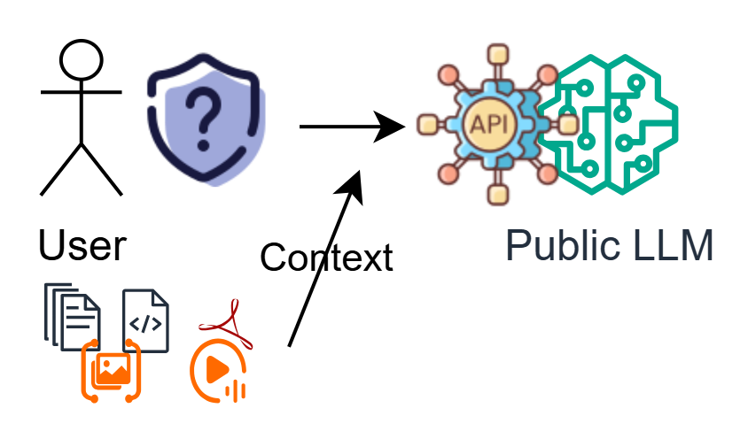
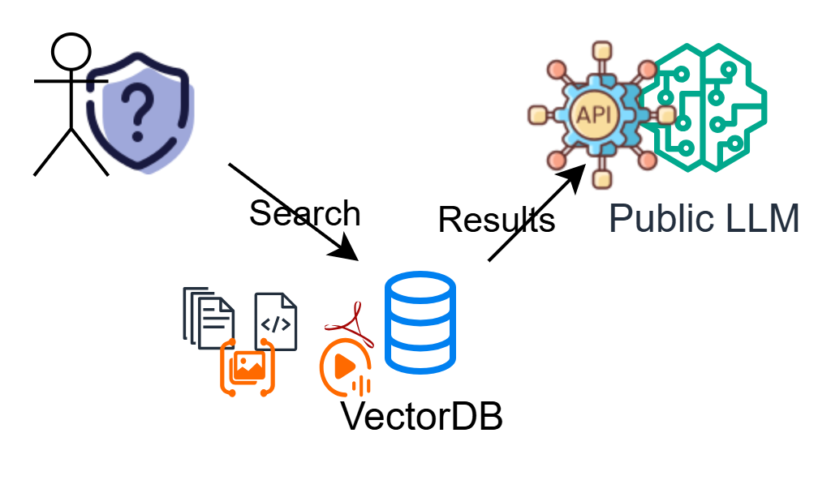
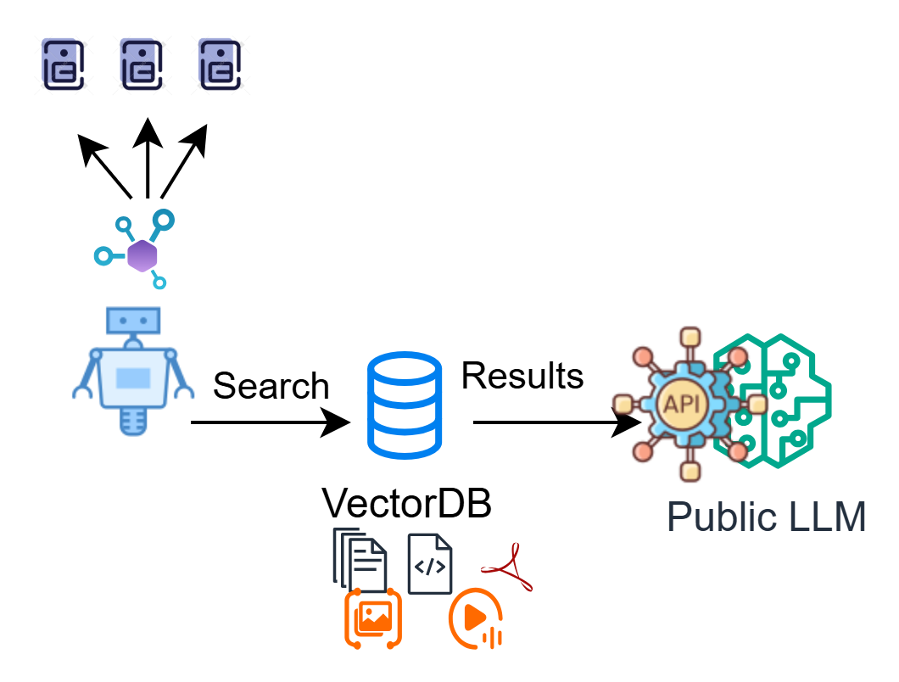
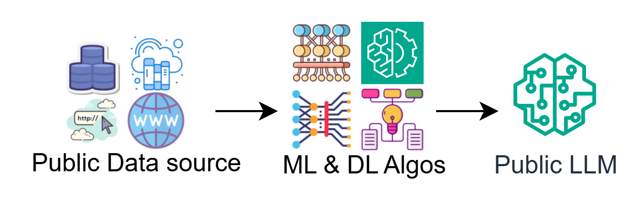
AI – Learning Path
PromptlyAI
Model Integration
Context & Retrieval (RAG)
Model Deployment
Agents & Orchestration

